Slide 1

o 
DATA71200 Advanced Data Analysis
Prof. Howard Everson
University of Pennsylvania, with grateful acknowledgement of the many others who made their course materials freely available online.


  

Slide 2
Why “Learn”?
Machine learning is programming computers to optimize a performance criterion using example data or past experience.
There is no need to “learn” to calculate payroll
Learning is used when:
Human expertise does not exist (navigating on Mars),
Humans are unable to explain their expertise (speech recognition)
Solution changes in time (routing on a computer network)
Solution needs to be adapted to particular cases (user biometrics)

Slide 3


လ
ဝ
 


ဢ P
ဢ T
ဢ E
PTE


Slide 4
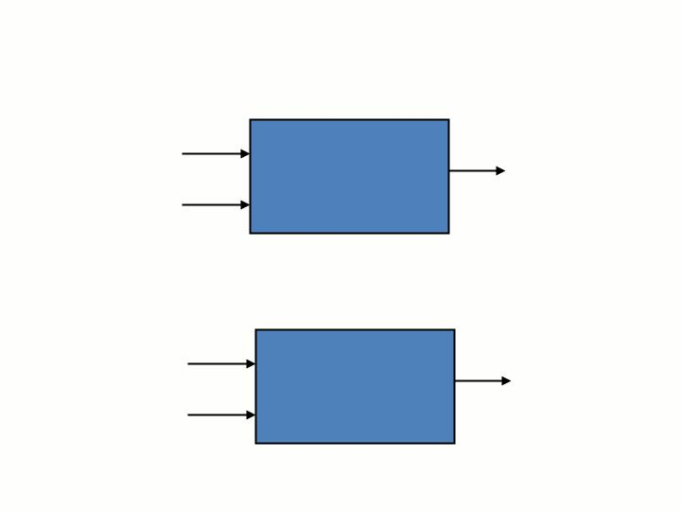













Slide 5
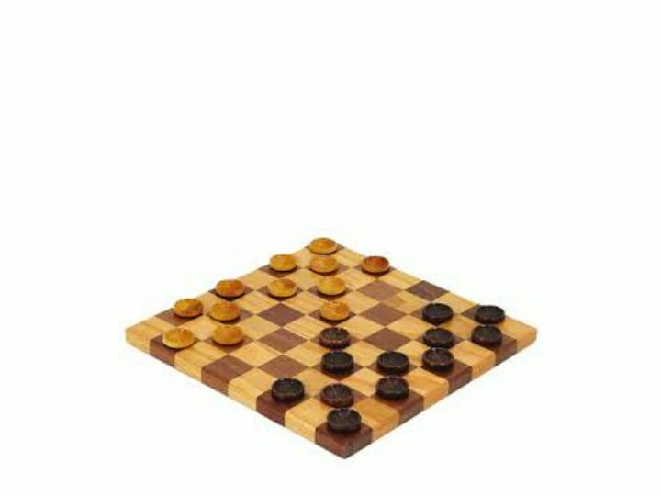
မ
လ

ဝ


Slide 6
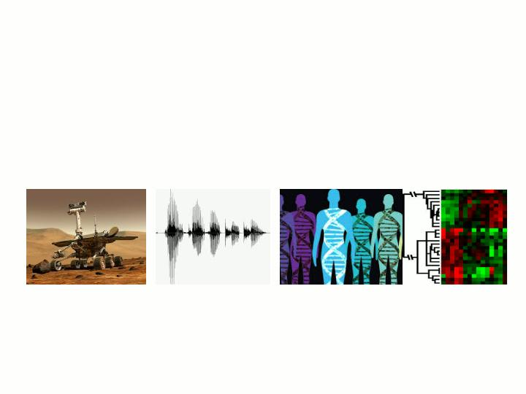

 
ဢ     
ဢ  မ     
ဢ     
ဢ      
မ  
ဢ     လဝ  



Slide 7
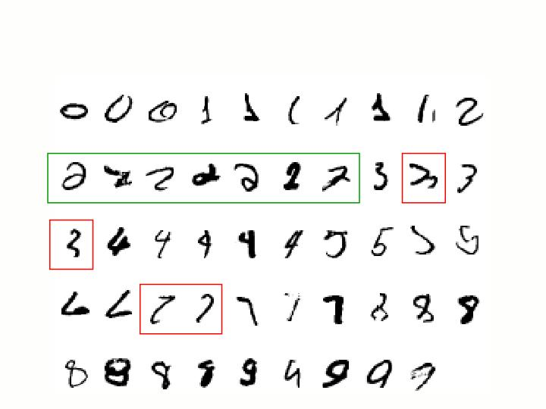





Slide 8



ဢ 
ဓ 
ဓ 
ဓ 
ဢ 
ဓ 
ဢ 
ဓ 
ဓ 
ဢ 
ဓ 



Slide 9








Face Recognition
Training examples of a person
Test images
AT&T Laboratories, Cambridge UK
http://www.uk.research.att.com/facedatabase.html

Slide 10

ဢ 
ဢ 
ဢ 
ဢ 
ဢ 
ဢ 
ဢ 
ဢ 
ဢ 
ဢ 



Slide 11



  
        
     
   
     
       
       
       
         
   
       
      
       



Slide 12




Slide 13
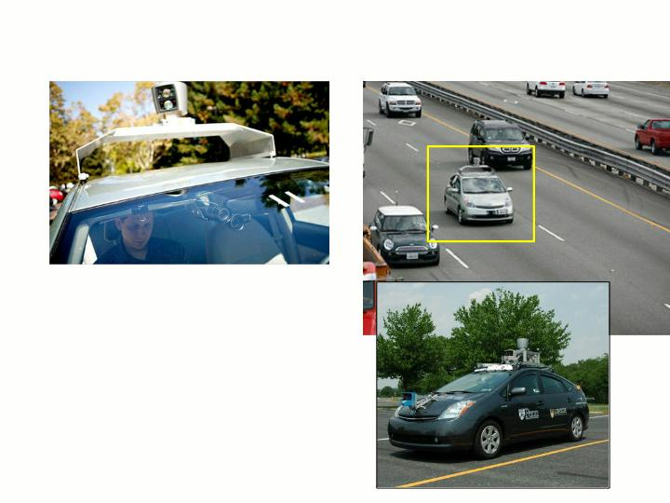

ဢ 


ဢ 



မ



Slide 14
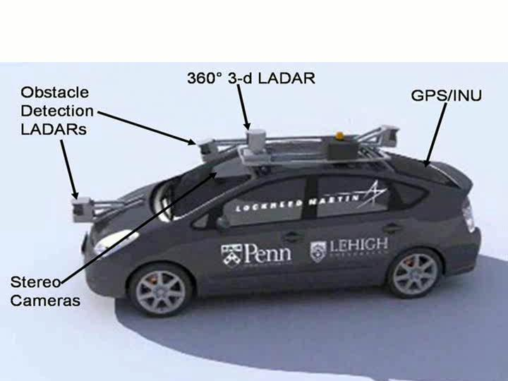



Slide 15
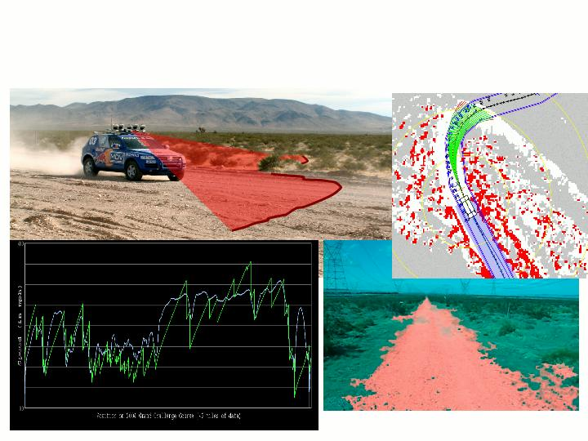









မ

Slide 16
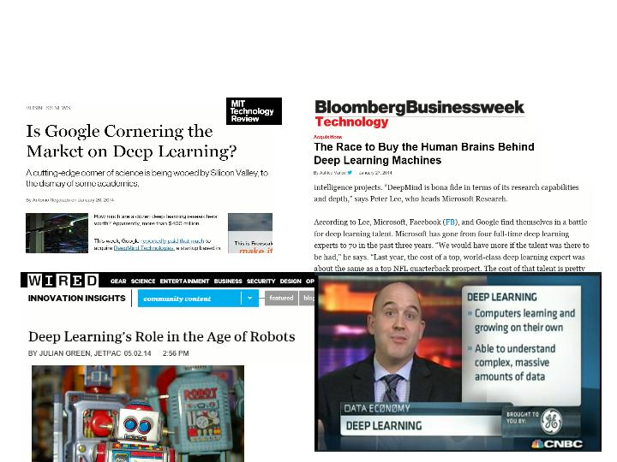


Slide 17
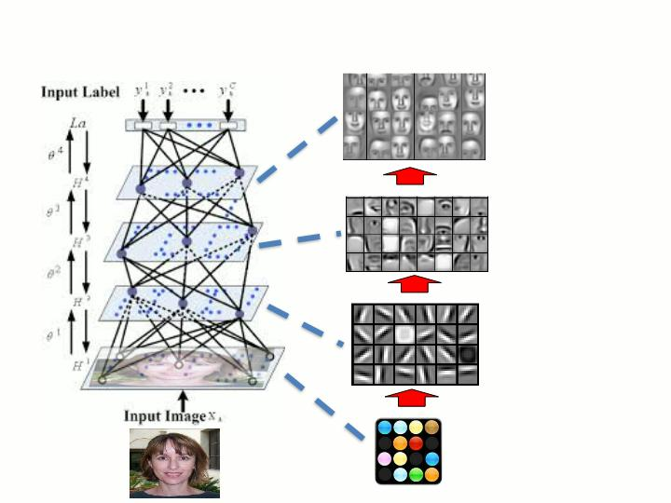

object models
object parts
(combination
of edges)
edges
pixels




Slide 18
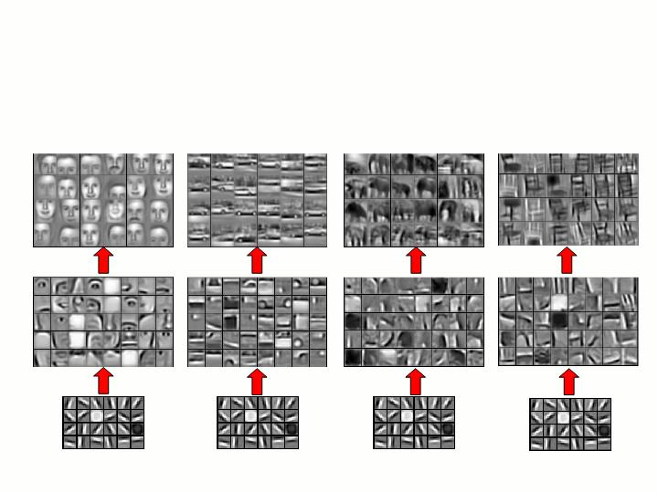









Slide 19
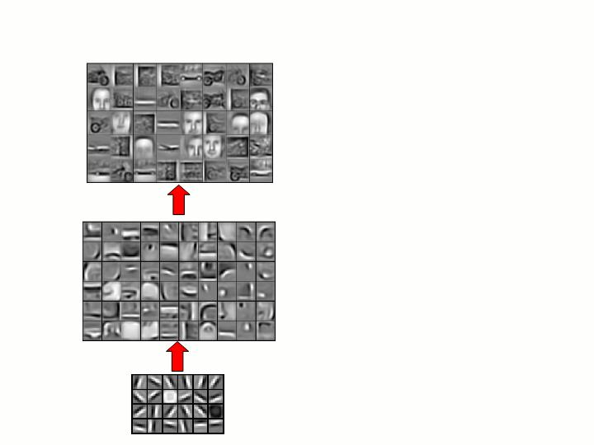










Slide 20
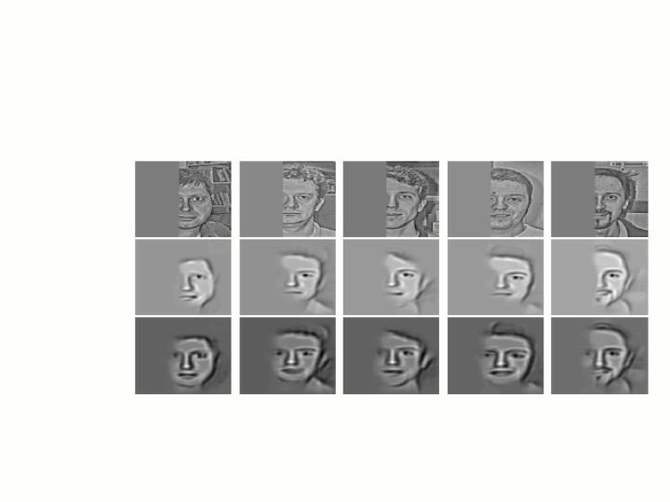

လဝ 












Slide 21
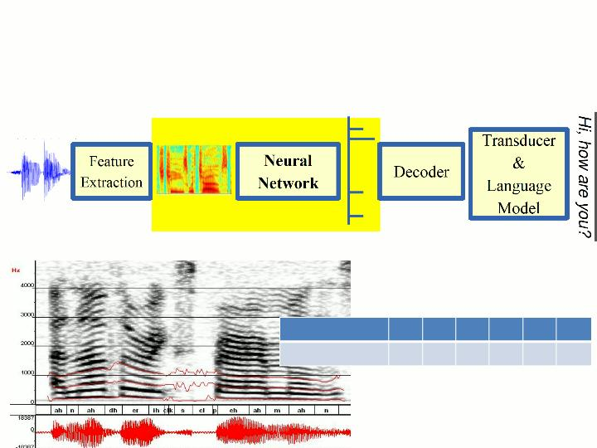





 







     

 လ
ဝ


Slide 22
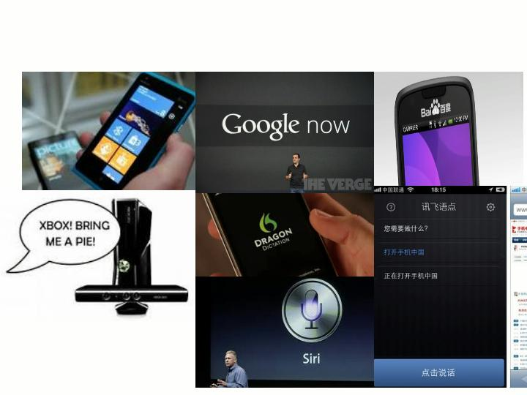




Slide 23



Slide 24

ဢ 
ဓ 
ဢ 
ဓ 
ဢ 
ဓ 
ဢ 
ဓ 



Slide 25
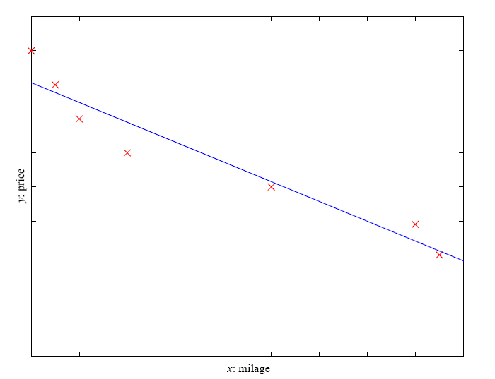
Prediction: Regression
Example: Price of a used car
x : car attributes
y : price
y = g (x | θ )
g ( ) model,
θ parameters
y = bx+a₀

Slide 26
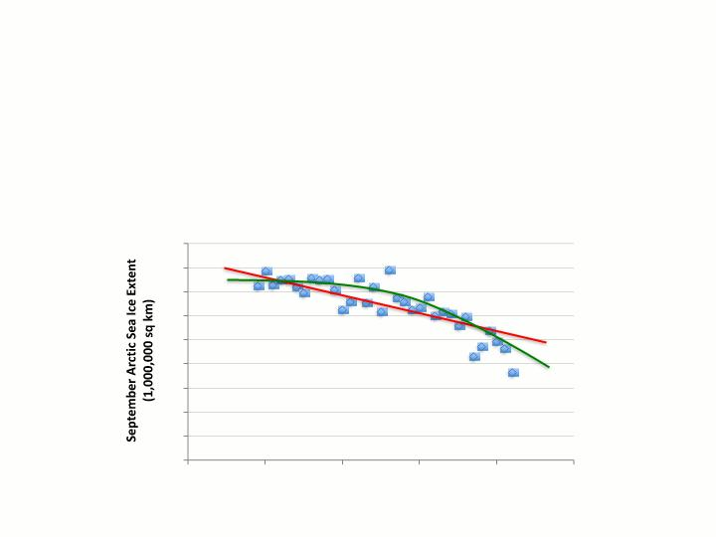

ဢ x y x y x y 
 
 
 
ဢ fxy x
ဓ y 




















Slide 27
Regression Applications
Navigating a car: Angle of the steering wheel (CMU NavLab)
Kinematics of a robot arm
(x,y)
α₁= g₁(x,y)
α₂= g₂(x,y)
α₂
α₁

Slide 28
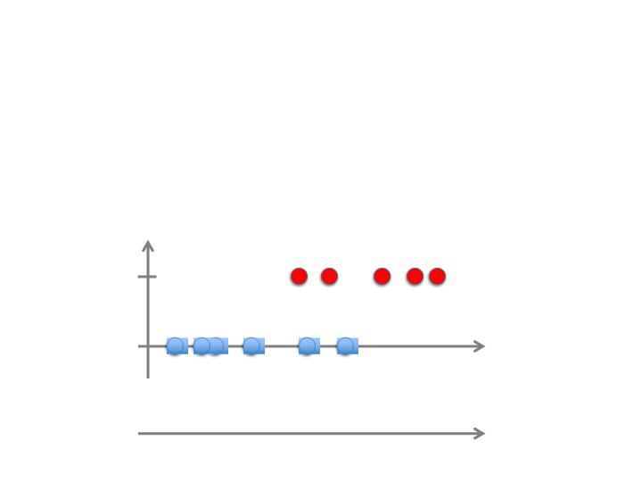

ဢ x y x y x y 
 
 
 
ဢ fxy x
ဓ y 








Slide 29
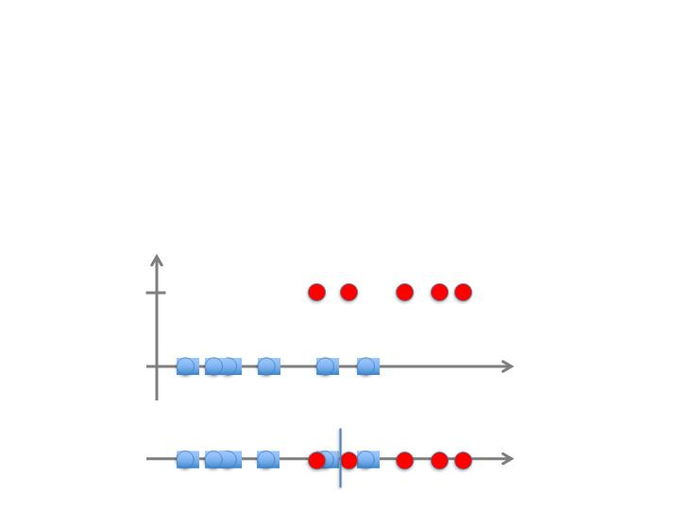

ဢ x y x y x y 
 
 
 
ဢ fxy x
ဓ y 




 




Slide 30
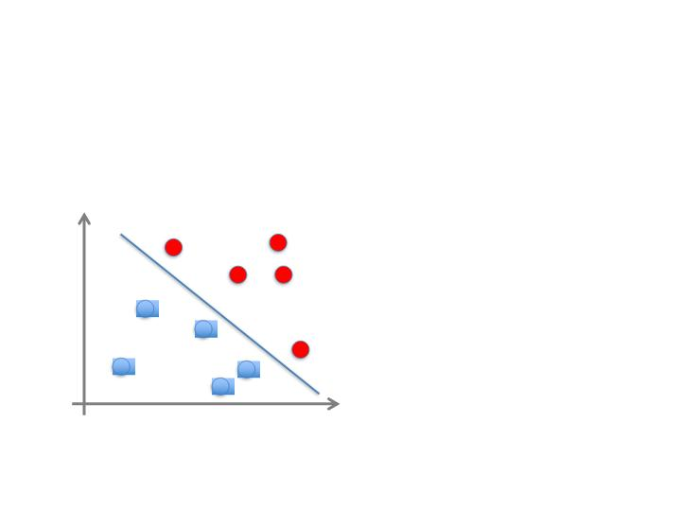

ဢ x 
ဓ 
 
 
 
ဦ





Slide 31
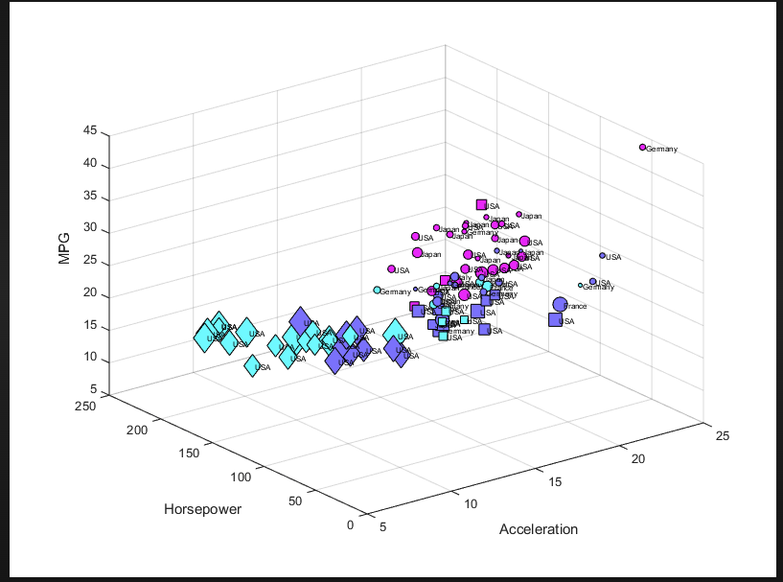
Example of Multi-dimensional Data Structure

Slide 32
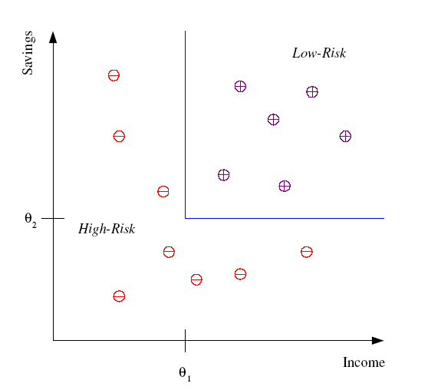
Classification
Example: Credit scoring
Differentiating between low-risk and high-risk customers from their income and savings
Discriminant: IF income > θ₁ AND savings > θ₂
THEN low-risk ELSE high-risk
Model

Slide 33
Unsupervised Learning
Learning “what normally happens”
No output variables are available
The learning algorithm is just shown the input data and asked to extract knowledge from these data.
Clustering: Grouping similar instances
Other applications: Summarization, Association Analysis
Example applications
Customer segmentation in CRM
Image compression: Color quantization
Bioinformatics: Learning motifs

Slide 34
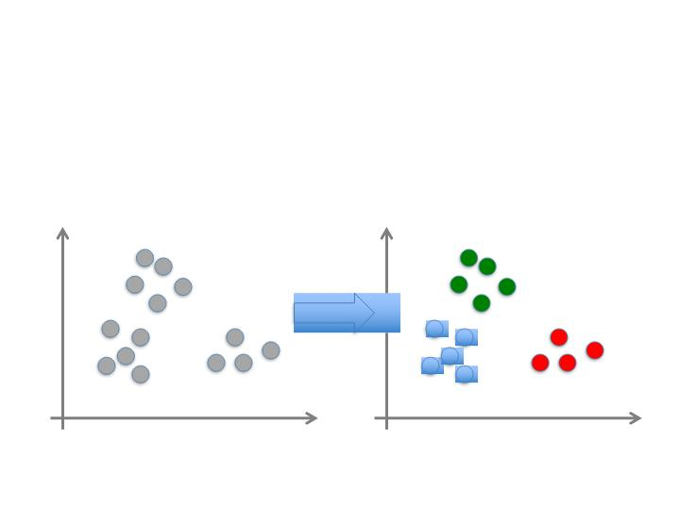

ဢ x x x 
 

ဢ xမ
ဓ 


Slide 35
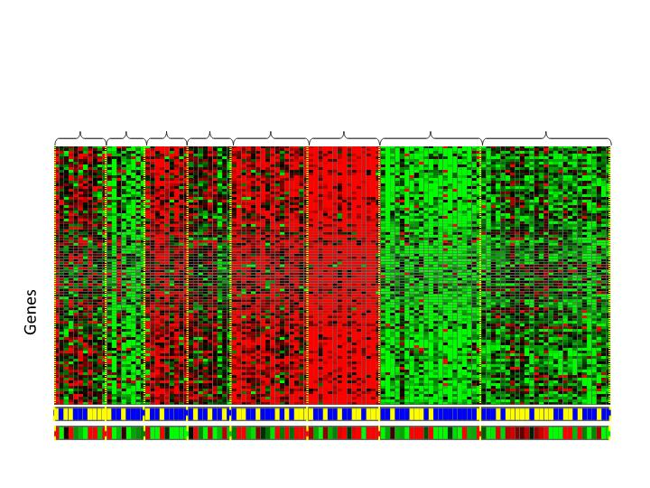






Slide 36
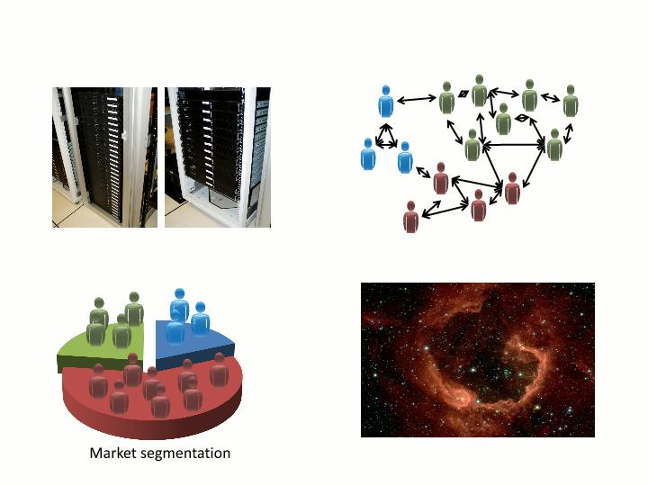



 




Slide 37
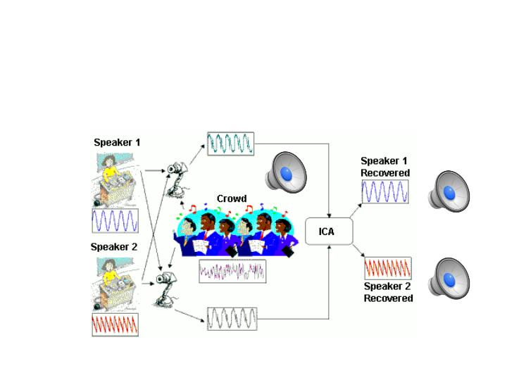

ဢ ဓ 


 

Slide 38
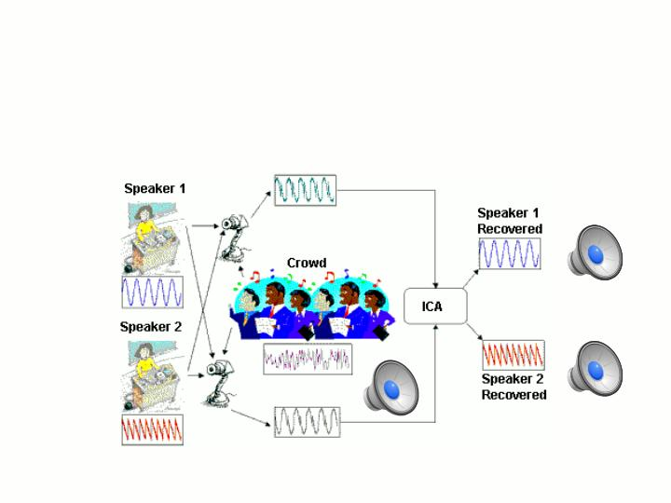

ဢ ဓ 


 

Slide 39
Reinforcement Learning
Reinforcement learning (RL) is a framework in which an agent learns by interacting with an environment and receiving feedback in the form of rewards or penalties. Unlike supervised learning — where the model learns from labeled examples of correct answers — the RL agent has no teacher telling it what the right action is. It simply tries things, observes what happens, and gradually adjusts its behavior to maximize cumulative reward over time.
The core components are an agent (the learner), an environment (everything the agent interacts with), a state (the agent's current situation), an action (what the agent can do), and a reward signal (numerical feedback after each action). The agent's goal is to learn a policy — a mapping from states to actions — that maximizes expected total reward across a sequence of decisions.

Slide 40

ဢ      
 
ဓ       
     
ဢ 
ဓ   
ဓ 
ဓ 
ဓ 


Slide 41
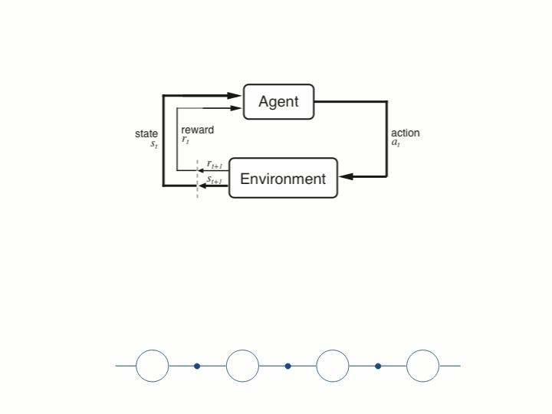

Agent and environment interact at discrete time steps : t = 0, 1, 2, K
Agent observes state at step t: s_{t} ለS
produces action at step t : a ለ A(s )
t
t
gets resulting reward : r_{t +1} ለᄜ
and resulting next state : s_{t +1}
r
r
r
t
. . .
s_{t}
^{t } s_{tꢀ a}
^{t } s_{tꢀ a}
 stꢀ
. . .
t 
a
t
t 
t 
a



Slide 42
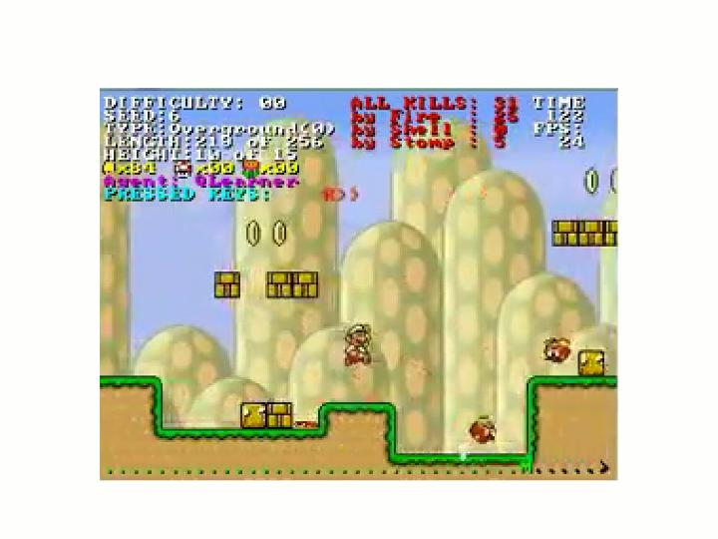




Slide 43
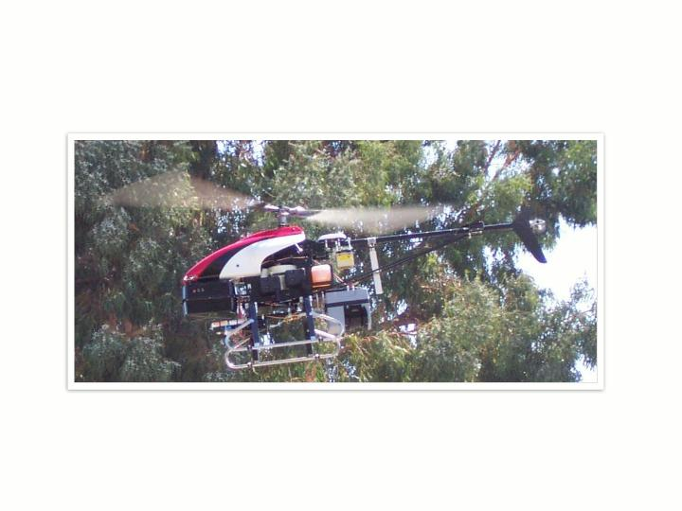

ဢ 





Slide 44



Slide 45
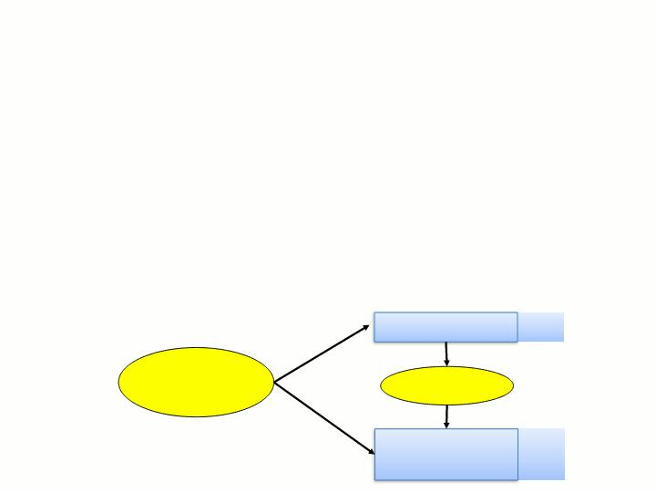

ဢ 
ဢ 
ဓ targetꢀfunction
ဢ 
ဢ 












Slide 46

ဢ 


ဓ လဝလ
ဝ
ဢ 
collectiveꢀclassification
ဢ 
transferꢀlearning



Slide 47

ဢ 

ဓ 
ဢ 
ဓ 
ဓ 
ဓ 



Slide 48

ဢ 
ဓ 
ဓ 
ဓ 
ဢ 
ဓ 
ဓ 
ဓ 
ဢ 
ဓ 
ဓ 
ဢ 
ဓ 
ဓ 
ဓ 
ဓ 
ဓ 



Slide 49


ဢ 
ဓ 
ဓ 
ဢ 
ဓ 
ဓ 
ဢ 
ဓ 
ဓ 
ဢ 
ဓ 
ဓ 
ဓ 



Slide 50

ဢ 
ဢ 
ဢ 
ဢ 
ဢ 
ဢ 
ဢ 
ဢ 
ဢ 
ဢ 



Slide 51


ဢ 
ဢ 
 ဢ 
ဢ 
ဢ 



Slide 52

ဢ 

ဢ 


ဢ 





Slide 53
Which Topics Deserve More Coverage —if we had more time?
Graphical Models/Belief Networks (just ran out of time)
More on Adaptive Systems
Learning Theory
More on Clustering and Association Analysiscovered by Data Mining Course
More on Feature Selection, Feature Creation
More on Prediction
Possibly: More depth coverage of optimization techniques, neural networks, hidden Markov models, how to conduct a machine learning experiment, comparing machine learning algorithms,…

Slide 54




Slide 55

ဢ 
ဓ မ
ဓ မ
ဢ 
ဓ 
ဓ 
ဓ 
ဓ   
ဢ 
ဓ 
ဓ မ
ဓ 
ဓ မ
ဓ မ 
ဓ 
ဓ 



Slide 56

ဢ 
ဓ 
ဓ 
ဓ 
ဓ 
ဓ 
ဓ 
ဓ 
ဓ မ 
ဓ 
ဢ 
ဓ 
ဓ 
ဓ 
ဓ 
ဓ 
ဓ 
ဓ 



Slide 57

ဢ 
ဓ 
ဓ 
ဓ 
ဓ 
ဓ 
ဓ 
ဓ 
ဓ 
ဓ 
ဓ 
ဢ 
ဓ 
ဓ 
ဓ 
ဓ 
ဓ 
ဓ 



Slide 58
What We Talk About When We Talk About“Learning”
Learning general models from a data of particular examples
Data are cheap and abundant (data warehouses, data marts); knowledge is expensive and scarce.
Example in retail: Customer transactions to consumer behavior:
People who bought “Da Vinci Code” also bought “The Five People You Meet in Heaven” (www.amazon.com)
Build a model that is a good and useful approximation to the data.

Slide 59
Data Mining/KDD
Definition := “KDD is the non-trivial process of
identifying valid, novel, potentially useful, and
ultimately understandable patterns in data” (Fayyad)
Applications:
Retail: Market basket analysis, Customer relationship management (CRM)
Finance: Credit scoring, fraud detection
Manufacturing: Optimization, troubleshooting
Medicine: Medical diagnosis
Telecommunications: Quality of service optimization
Bioinformatics: Motifs, alignment
Web mining: Search engines
...

Slide 60
What is Machine Learning?
Machine Learning
Study of algorithms that
improve their performance
at some task
with experience
Optimize a performance criterion using example data or past experience.
Role of Statistics: Inference from a sample
Role of Computer science: Efficient algorithms to
Solve the optimization problem
Representing and evaluating the model for inference

Slide 61
Growth of Machine Learning
Machine learning is preferred approach to
Speech recognition, Natural language processing
Computer vision
Medical outcomes analysis
Robot control
Computational biology
This trend is accelerating
Improved machine learning algorithms
Improved data capture, networking, faster computers
Software too complex to write by hand
New sensors / IO devices
Demand for self-customization to user, environment
It turns out to be difficult to extract knowledge from human expertsfailure of expert systems in the 1980’s.

Slide 62
Applications
Association Analysis
Supervised Learning
Classification
Regression/Prediction
Unsupervised Learning
Reinforcement Learning

Slide 63
Learning Associations
Basket analysis:
P (Y | X ) probability that somebody who buys X also buys Y where X and Y are products/services.
Example: P ( chips | beer ) = 0.7
Market-Basket transactions

Slide 64
Classification: Applications
Aka Pattern recognition
Face recognition: Pose, lighting, occlusion (glasses, beard), make-up, hair style
Character recognition: Different handwriting styles.
Speech recognition: Temporal dependency.
Use of a dictionary or the syntax of the language.
Sensor fusion: Combine multiple modalities; eg, visual (lip image) and acoustic for speech
Medical diagnosis: From symptoms to illnesses
Web Advertizing: Predict if a user clicks on an ad on the Internet.

Slide 65
Reinforcement Learning
Topics:
Policies: what actions should an agent take in a particular situation
Utility estimation: how good is a state (used by policy)
No supervised output but delayed reward
Credit assignment problem (what was responsible for the outcome)
Applications:
Game playing
Robot in a maze
Multiple agents, partial observability, ...

Slide 66
Resources: Datasets
UCI Repository: http://www.ics.uci.edu/~mlearn/MLRepository.html
UCI KDD Archive: http://kdd.ics.uci.edu/summary.data.application.html
Statlib: http://lib.stat.cmu.edu/
Delve: http://www.cs.utoronto.ca/~delve/

Slide 67
Resources: Journals
Journal of Machine Learning Research www.jmlr.org
Machine Learning
IEEE Transactions on Neural Networks
IEEE Transactions on Pattern Analysis and Machine Intelligence
Annals of Statistics
Journal of the American Statistical Association
...

